Slide 1
Chapter 2: Understanding Java Language, Java operators and control flow

Slide 2
Learning Objectives
Language keywords
Naming rules and conventions for identifiers
Data types
Building blocks of a program (variables, methods and objects)
Objects and classes.
Arithmetic Operators
Increment or Decrement Operator
Relational Operators
Equality Operators
Logical operators
Short-circuit(or conditional) operators
Ternary operator
Assignment Operators
Type Casting
Selection Statements
Iteration Statements
Transfer Statements

Slide 3
A program is made up of…
Variable: named instance of memory reserved for a specific type of data, e.g. int age – here age is the name of memory area reserved for storing an int (32 bit integer value).
Constant: name for a memory location reserved for storing values that would not change during the execution of the program.
Operator: symbol/word or sign that indicates an instruction to do something on it’s operand/s.
Expression: piece of code that produces a value – e.g. 10 or 4 + 5 or a * b or 10==10
Statement: complete line/piece of code of code that does something
e.g. int totalValue = price * unitValue; this statement calculates the total price for all items in an order and stores the result in an integer variable (NOTE: price and unitValue are variables which can have different values at runtime).
Conditional: constructs to validate conditions to branch execution flow.
e.g. if (age<18) System.out.println(“You are a Minor); this code snippet performs check on the value of the age and if the age is less than 18 it prints a message “You are a minor”
Loop: constructs for executing code blocks repetitively.
Methods: a named block of code that might take input values and might return an output.

Slide 4
Primitive Data Types
The Java programming language is statically-typed, which means that all variables must first be declared before they can be used. This involves stating the variable's type and name.
A variable's data type determines the values it may contain, plus the operations that may be performed on it. In addition to int, the Java programming language supports seven other primitive data types. A primitive type is predefined by the language and is named by a reserved keyword. Primitive values do not share state with other primitive values. The eight primitive data types supported by the Java programming language are:
byte: The byte data type is an 8-bit signed two's complement integer. It has a minimum value of -128 and a maximum value of 127 (inclusive).
short: The short data type is a 16-bit signed two's complement integer. It has a minimum value of -32,768 and a maximum value of 32,767 (inclusive).
int: By default, the int data type is a 32-bit signed two's complement integer, which has a minimum value of -2³¹ and a maximum value of 2³¹-1. In Java SE 8 and later, you can use the int data type to represent an unsigned 32-bit integer, which has a minimum value of 0 and a maximum value of 2³²-1.
long: The long data type is a 64-bit two's complement integer. The signed long has a minimum value of -263 and a maximum value of 2⁶³-1. In Java SE 8 and later, you can use the long data type to represent an unsigned 64-bit long, which has a minimum value of 0 and a maximum value of 2⁶⁴-1.
float: The float data type is a single-precision 32-bit IEEE 754 floating point. This data type should never be used for precise values, such as currency – use java.math.BigDecimal instead.
double: The double data type is a double-precision 64-bit IEEE 754 floating point. This data type should never be used for precise values, such as currency.
boolean: The boolean data type has only two possible values: true and false.
char: The char data type is a single 16-bit Unicode character. It has a minimum value of '\u0000' (or 0) and a maximum value of '\uffff' (or 65,535 inclusive).

Slide 5
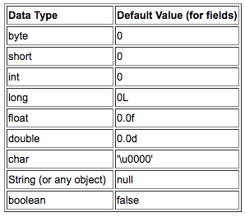
Primitive Data Types: Default Values

Slide 6
Primitive Data Types
Every programming language has its own set of rules and conventions for the kinds of names that you're allowed to use, and the Java programming language is no different. The rules and conventions for naming your variables can be summarized as follows:
Variable names are case-sensitive. A variable's name can be any legal identifier — an unlimited-length sequence of Unicode letters and digits, beginning with a letter, the dollar sign "$", or the underscore character "_". The convention, however, is to always begin your variable names with a letter, not "$" or "_". Additionally, the dollar sign character, by convention, is never used at all. You may find some situations where auto-generated names will contain the dollar sign, but your variable names should always avoid using it. A similar convention exists for the underscore character; while it's technically legal to begin your variable's name with "_", this practice is discouraged. White space is not permitted.
Subsequent characters may be letters, digits, dollar signs, or underscore characters. Conventions (and common sense) apply to this rule as well. When choosing a name for your variables, use full words instead of cryptic abbreviations. Doing so will make your code easier to read and understand. In many cases it will also make your code self-documenting; fields named cadence, speed, and gear, for example, are much more intuitive than abbreviated versions, such as s, c, and g. Also keep in mind that the name you choose must not be a keyword or reserved word.
If the name you choose consists of only one word, spell that word in all lowercase letters. If it consists of more than one word, capitalize the first letter of each subsequent word. The names gearRatio and currentGear are prime examples of this convention. If your variable stores a constant value, such as static final int NUM_GEARS = 6, the convention changes slightly, capitalizing every letter and separating subsequent words with the underscore character. By convention, the underscore character is never used elsewhere.

Slide 7
Operators
Operators are special symbols that perform specific operations on one, two, or three operands, and then return a result.
As we explore the operators of the Java programming language, it may be helpful for you to know ahead of time which operators have the highest precedence. The operators in the following table are listed according to precedence order. The closer to the top of the table an operator appears, the higher its precedence. Operators with higher precedence are evaluated before operators with relatively lower precedence. Operators on the same line have equal precedence. When operators of equal precedence appear in the same expression, a rule must govern which is evaluated first. All binary operators except for the assignment operators are evaluated from left to right; assignment operators are evaluated right to left.

Slide 8
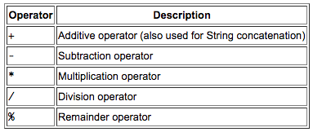
Operators: Assignment, Arithmetic, and Unary
The Simple Assignment Operator:
One of the most common operators that you'll encounter is the simple assignment operator "=”.
This operator can also be used on objects to assign object references
The Arithmetic Operators:
The Java programming language provides operators that perform addition, subtraction, multiplication, and division. There's a good chance you'll recognize them by their counterparts in basic mathematics.
The only symbol that might look new to you is "%", which divides one operand by another and returns the remainder as its result.

Slide 9
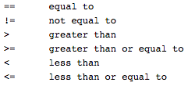

Operators: Equality, Relational, and Conditional
The Equality and Relational Operators:
The equality and relational operators determine if one operand is greater than, less than, equal to, or not equal to another operand. The majority of these operators will probably look familiar to you as well. Keep in mind that you must use "==", not "=", when testing if two primitive values are equal.
The Conditional Operators:
The && and || operators perform Conditional-AND and Conditional-OR operations on two boolean expressions. These operators exhibit "short-circuiting" behavior, which means that the second operand is evaluated only if needed.
Another conditional operator is ?:, which can be thought of as shorthand for an if-then-else statement (discussed in the Control Flow Statements section of this lesson). This operator is also known as the ternary operator because it uses three operands.

Slide 10
Operators: Type Comparison (instanceof)
The instanceof operator compares an object to a specified type. You can use it to test if an object is an instance of a class, an instance of a subclass, or an instance of a class that implements a particular interface.
We will discuss the classes, types and interfaces later in the course

Slide 11
Operators: Bitwise and Bit Shift
The Java programming language also provides operators that perform bitwise and bit shift operations on integral types.
The unary bitwise complement operator "~" inverts a bit pattern; it can be applied to any of the integral types, making every "0" a "1" and every "1" a "0". For example, a byte contains 8 bits; applying this operator to a value whose bit pattern is "00000000" would change its pattern to "11111111".
The signed left shift operator "<<" shifts a bit pattern to the left, and the signed right shift operator ">>" shifts a bit pattern to the right. The bit pattern is given by the left-hand operand, and the number of positions to shift by the right-hand operand. The unsigned right shift operator ">>>" shifts a zero into the leftmost position, while the leftmost position after ">>" depends on sign extension.
The bitwise & operator performs a bitwise AND operation.
The bitwise ^ operator performs a bitwise exclusive OR operation.
The bitwise | operator performs a bitwise inclusive OR operation.

Slide 12
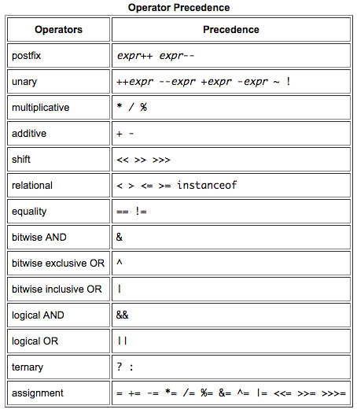
Operators - Precedence

Slide 13
Expressions, Statements, and Blocks
Operators may be used in building expressions, which compute values; expressions are the core components of statements; statements may be grouped into blocks.
Expressions: An expression is a construct made up of variables, operators, and method invocations, which are constructed according to the syntax of the language, that evaluates to a single value.
Statements: A statement forms a complete unit of execution.
Blocks: A block is a group of zero or more statements between balanced braces and can be used anywhere a single statement is allowed.

Slide 14
Control Flow Statements
The statements inside your source files are generally executed from top to bottom, in the order that they appear.
Control flow statements, however, break up the flow of execution by employing decision making, looping, and branching, enabling your program to conditionally execute particular blocks of code.
The following are control flow constructs available in Java:
Decision-making statements
if-then
if-then-else
if-then-else-if-then-else
switch
Looping statements:
for
while
do-while
Branching statements:
break
continue
return

Slide 15
Decision Making Statements
The if-then Statement: The if-then statement is the most basic of all the control flow statements. It tells your program to execute a certain section of code only if a particular test evaluates to true.
The if-then-else Statement: The if-then-else statement provides a secondary path of execution when an "if" clause evaluates to false.
The if-then-else-if-then-else: This is useful when you have multiple decision branches that can stem out in your application logic, if-then-else statements are ideal when you have a binary decision tree but when the decision tree has more than one choice then you can use if-then-else-if-then-else construct.
The switch Statement: Unlike if-then and if-then-else statements, the switch statement can have a number of possible execution paths. A switch works with the byte, short, char, and int primitive data types. It also works with enumerated types (discussed later in the course), the String class, and a few special classes that wrap certain primitive types: Character, Byte, Short, and Integer.
Deciding whether to use if-then-else statements or a switch statement is based on readability and the expression that the statement is testing. An if-then-else statement can test expressions based on ranges of values or conditions, whereas a switch statement tests expressions based only on a single integer, enumerated value, or String object.
Another point of interest is the break statement. Each break statement terminates the enclosing switch statement. Control flow continues with the first statement following the switch block. The break statements are necessary because without them, statements in switch blocks fall through: All statements after the matching case label are executed in sequence, regardless of the expression of subsequent case labels, until a break statement is encountered.

Slide 16
Loop Statements
The while statement: The while statement continually executes a block of statements while a particular condition is true. The while statement evaluates expression, which must return a boolean value. If the expression evaluates to true, the while statement executes the statement(s) in the while block. The while statement continues testing the expression and executing its block until the expression evaluates to false.
The do-while statement: The difference between do-while and while is that do-while evaluates its expression at the bottom of the loop instead of the top. Therefore, the statements within the do block are always executed at least once
The for Statement: The for statement provides a compact way to iterate over a range of values. Programmers often refer to it as the "for loop" because of the way in which it repeatedly loops until a particular condition is satisfied.
When using this version of the for statement, keep in mind that:
The initialization expression initializes the loop; it's executed once, as the loop begins.
When the termination expression evaluates to false, the loop terminates.
The increment expression is invoked after each iteration through the loop; it is perfectly acceptable for this expression to increment or decrement a value.
The enhanced for loop: The for statement also has another form designed for iteration through Collections and arrays This form is sometimes referred to as the enhanced for statement, and can be used to make your loops more compact and easy to read.

Slide 17
Branching Statements
The break Statement: The break statement has two forms: labeled and unlabeled. You saw the unlabeled form in the previous discussion of the switch statement. You can also use an unlabeled break to terminate a for, while, or do-while loop. An unlabeled break statement terminates the innermost switch, for, while, or do-while statement, but a labeled break terminates an outer statement.
The continue Statement: The continue statement skips the current iteration of a for, while , or do-while loop. The unlabeled form skips to the end of the innermost loop's body and evaluates the boolean expression that controls the loop. A labeled continue statement skips the current iteration of an outer loop marked with the given label.
The return Statement: The last of the branching statements is the return statement. The return statement exits from the current method, and control flow returns to where the method was invoked. The return statement has two forms: one that returns a value, and one that doesn't. To return a value, simply put the value (or an expression that calculates the value) after the return keyword. The data type of the returned value must match the type of the method's declared return value. When a method is declared void, use the form of return that doesn't return a value.

Slide 18
Examples: Chapter 2
See COREJ1-Chapter2 at https://github.com/CompleteJavaTraining/JavaEssentials/tree/master/Code/COREJ1-Chapter2

Slide 19
What are we learning in Next Chapter ?
You will learn about Java Access Modifiers
We will learn about:
Package declaration
Accessibility modifiers
Simple Imports & Static Imports
Java Programming Structures

Slide 20
Thank You !

